Slide 1
FTH-412 Industrial Microbiology
Introduction of Industrial Microbiology and Biotechnology
By
Assoc. Prof. Dr. Narumol Matan

Slide 2
CHARACTERISTICS OF INDUSTRIAL MICROBIOLOGY
The motivation is profit and the generation of wealth
The handled scale of microorganisms is large
and cultivated in fermentors
(≥50,000 liters)
The microorganisms or
their products have direct economic value

Slide 3
THE USE OF THE WORD
‘FERMENTATION’ IN INDUSTRIAL MICROBIOLOGY
The word fermentation comes from the Latin, which means to boil.
Fermentation in Industrial microbiology has three different meanings
1.The type of metabolism of a carbon source in which energy is generated by substrate and in which organic molecules function as the final electron acceptor generated during the break-down of carbon-containing compounds.
2. Any process in which micro-organisms are grown on a large scale, even if the final electron acceptor is not an organic compound
3. The processing of fermented food which microorganisms play a major part.
It originated from the releasing of gas bubbles during wine fermentation.

Slide 4
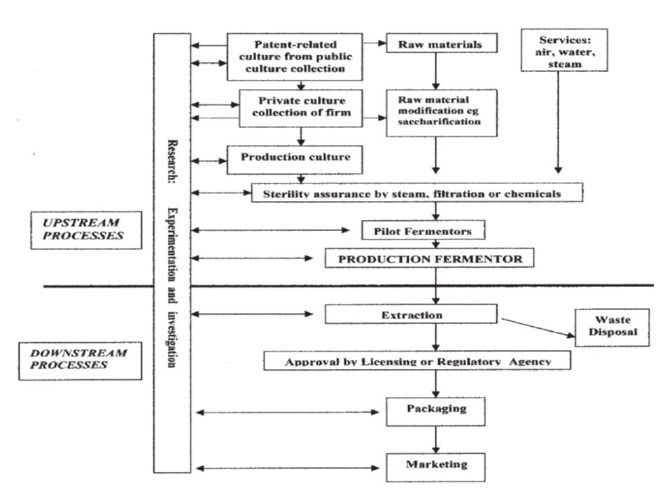
ORGANIZATIONAL SET-UP IN AN INDUSTRIAL
MICROBIOLOGY ESTABLISHMENT
Fig. 1.1 Set-up in an Industrial Microbiology Establishment

Slide 5
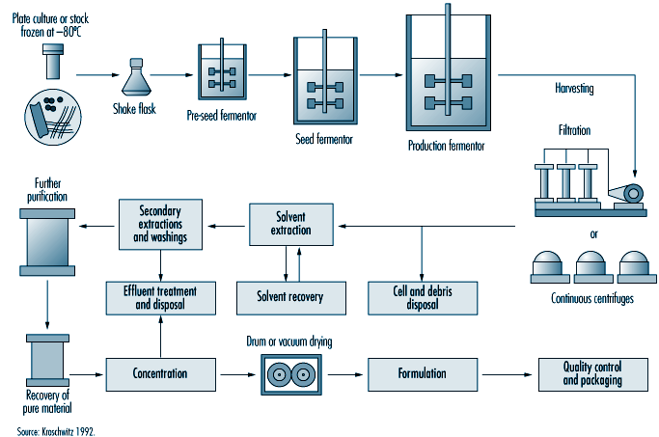
Fig. 1.2 Flowchart of the Production Process in a Typical Industrial Microbiology Establishment

Slide 6
Microorganisms in Industrial Microbiology and Biotechnology

Slide 7
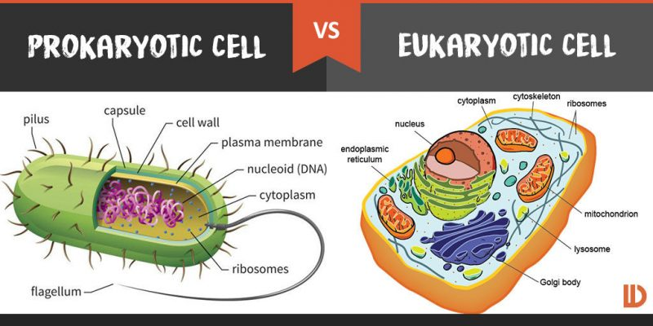
1. Nature of Cells of Living Systems

Slide 8
Cell wall: Procaryotic cell walls contain glycopeptides; these are absent in eukaryotic cells. Cell walls of eucaryotic cells contain chitin, cellulose and other sugar polymers.
Cell membrane: Composed of a double layer of phospholipids. It is not a passive barrier, but enables the cell to actively select the metabolites it wants to accumulate and to excrete waste products.
Ribosomes are the sites of protein synthesis. They consist of two sub-units. Procaryotic ribosomes are 70S (30S and a 50S). Eucaryotic ribosomes are 80S (40S and a 60S).
Mitochondria are membrane-enclosed structures where in aerobic eucaryotic cells the processes of respiration and energy release. Procaryotic cells lack mitochondria.
Nuclear membrane surrounds the nucleus in eukaryotic cells, but is absent in prokaryotic cells. In procaryotic cells only one DNA constitutes genome. Eucaryotic cells have DNA spread in several chromosomes.
Nucleolus is a structure within the eucaryotic nucleus for the synthesis of ribosomal RNA.

Slide 9
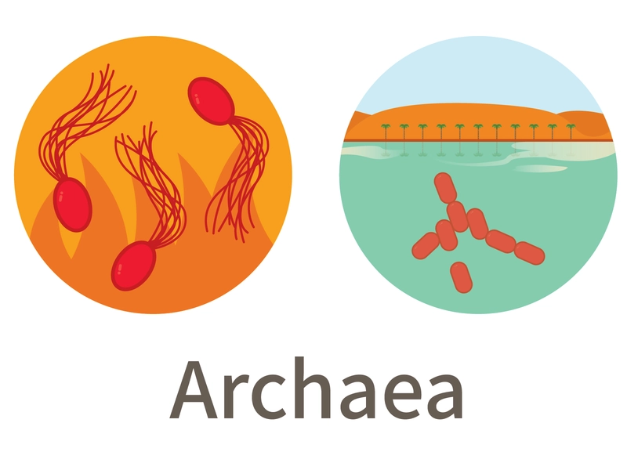
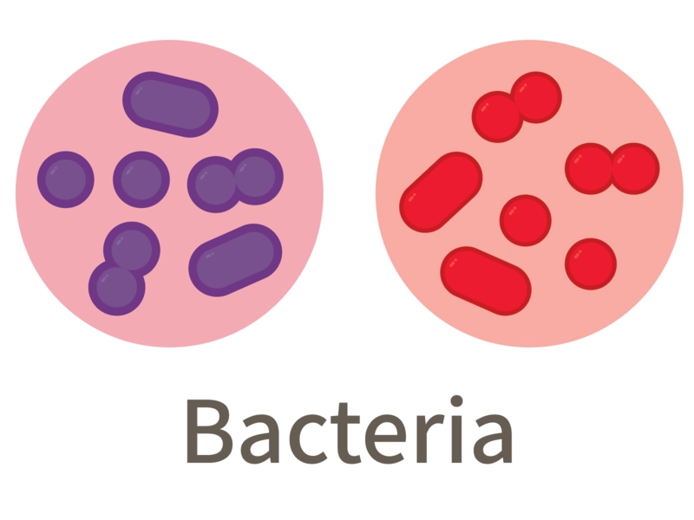
2. Classification of Living Organisms into three Domains
Protists
Fungi
Plants
Animals
DOMAINS
Industrial microbiology and biotechnology

Slide 10
Advantages of microorganisms over plants or animals as inputs in biotechnology:
Microorganisms grow rapidly in comparison with plants and animals.
The space requirement for growth microorganisms is small.
Microorganisms are not subject to the problems of the vicissitudes of weather
Microorganisms are not affected by diseases of plants and animals

Slide 11
3. Taxonomic Grouping of Industrial Microorganism
3.1 Bacteria
3.2 Eucarya: Fungi
3.1.1 The Proteobacteria
3.1.1.1 The Acetic Acid Bacteria
3.1.2 The Firmicutes
3.1.2.1 Spore forming firmicutes
3.1.2.2 Non-spore forming firmicutes
3.1.3 The Actinobacteria
3.1.3.1 The Actinomycetes
3.2.1 Phycomycetes
3.2.2 Ascomycetes
3.2.3 Fungi Imprfecti
3.2.4 Basidiomycetes

Slide 12
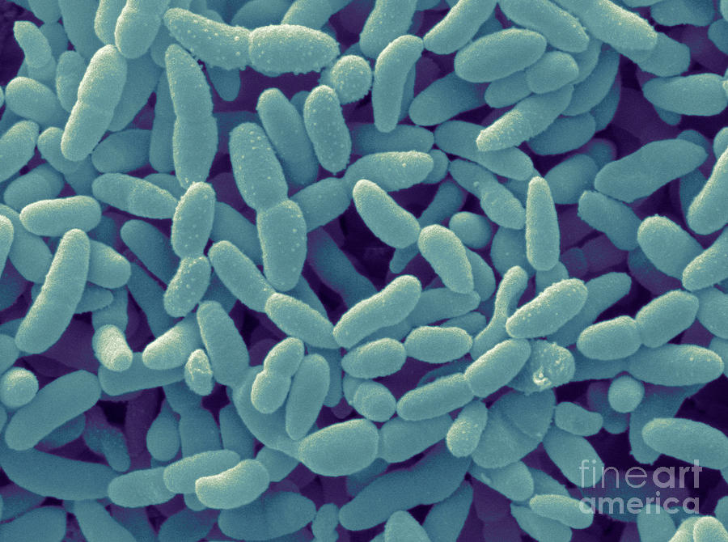
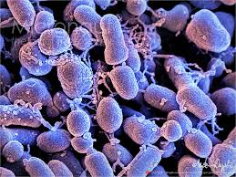
3.1.1 The Proteobacteria
All Proteobacteria are Gram-negative
Most members are facultatively or obligately anaerobic
Proteobacteria are divided into five groups: α (alpha), β (beta), ɣ (gamma), δ (delta), ε (epsilon)
The industrially important members : Acetobacter and Gluconobacter
3.1.1.1 The Acetic Acid Bacteria
They stand acid conditions of pH 5.0 or lower
They carry out incomplete oxidation of alcohol leading to the production of acetic acid
Acetobacter (peritrichously flagellated)
Gluconobacter (polarly flagellated)

Slide 13
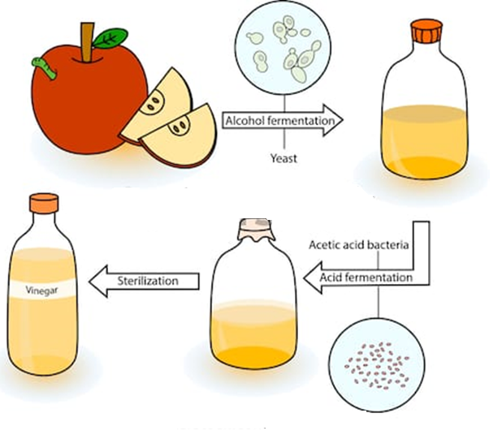
Products from Acetic Acid Bacteria
Production of glucoronic acid from glucose
Production of arabonic acid from arabinose
Production of galactonic aicd from galactose
Production of sorbose from sorbitol
Produce pure cellulose
Production of acetic acid or vinegar

Slide 14
3.1.2 The Firmicutes
All Firmicutes are Gram-positive
The industrially important members are divided into three major groups:
Spore-forming firmicutes
Non-spore forming firmicutes
Wall-less (this group contains pathogens and no industrial organisms.)
3.1.2.1 Spore forming firmicutes
The group is divided into two: Bacillus spp, which are aerobic and Clostridium spp which are anaerobic.
Bacillus spp are sometimes used in enzyme and insecticide production
B. papilliae infects and kills the larvae of the beetles
B. thuringiensis is used against mosquitoes
Clostridia on the other hand are mainly pathogens of humans and animals

Slide 15
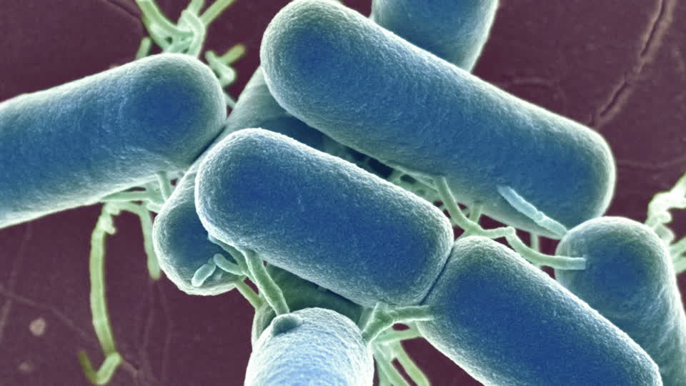
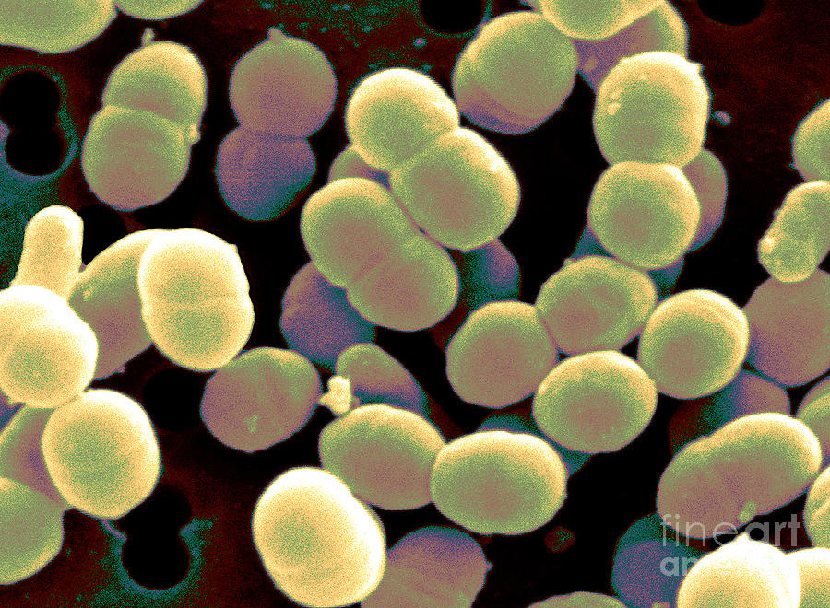
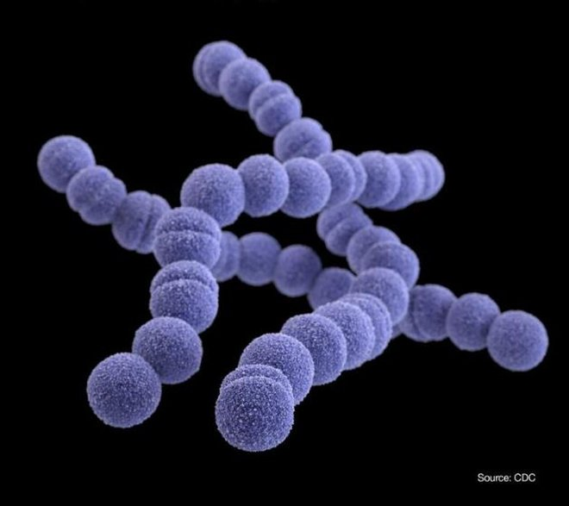
3.1.2.2 Non-spore forming firmicutes
The firmicutes group are very important in industry as they contain the lactic acid bacteria
The Lactic Acid Bacteria :
Shape: Rods or cocci
Genera: Enterococcus, Lactobacillus, Lactococcus, Leuconostoc, Pediococcus and Streptococcus
Lactic acid bacteria are divided into two major groups:
The homofermentative group, which produce lactic acid as the sole product of the fermentation of sugars,
The heterofermentative group, which produce ethanol, as well as CO₂.

Slide 16
Use of Lactic Acid Bacteria for Industrial Purposes:
The desirable characteristics of lactic acid bacteria as industrial microorganisms include
a. their ability to rapidly and completely ferment cheap raw materials,
b. their minimal requirement of nitrogenous substances,
c. they produce high yields of the much preferred stereo specific lactic acid
d. ability to grow under conditions of low pH and high temperature, and
e. ability to produce low amounts of cell mass as well as negligible amounts of other byproducts.

Slide 17
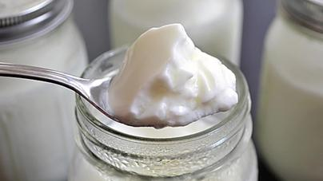
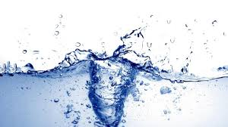
3.1.3 The Actinobacteria
The Acinobacteria are the Firmicutes with G+C content of 50% or higher.
Many members of the group have the tendency to form filaments or hyphae.
The industrially important members :
Pediococcus required in special beers such as lambic beer
Lactococcus and Streptococcusused as starter in yoghurt manufacture
Enterococcus used to monitor water quality, (like E. coli)
Leuconostoc involved in the pickling of vegetables; produce dextrans from sucrose

Slide 18
3.1.3 The Actinobacteria
3.1.3.1 The Actinomycetes
They have branching filamentous hyphae, which somewhat resemble the mycelia of the fungi
They have petidoglycan in their cell walls, and second they are about 1.0 -1.5 µ in diameter
They produce secondary metabolites (like antibiotics) which are of industrial importance, especially as pharmaceuticals.

Slide 19
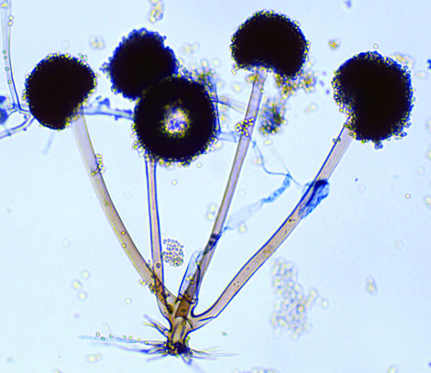
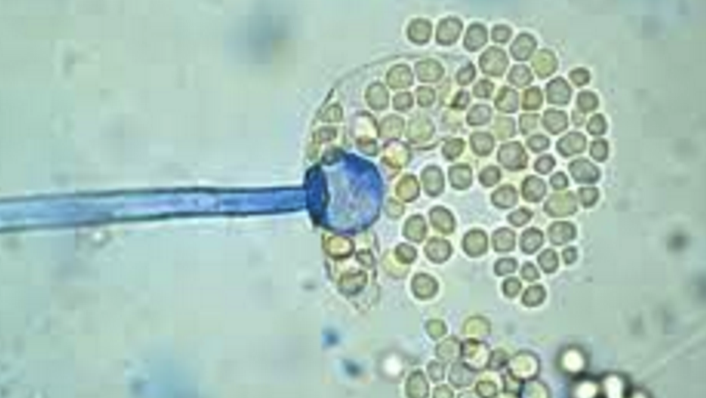
3.2 Eucarya: Fungi
The fungi are traditionally classified into the four groups
Phycomycetes
Ascomycetes
Fungi Imprfecti
Basidiomycetes
3.2.1 Phycomycetes
The industrially important members are Rhizopus and Mucor which are used for producing various enzymes
Rhizopus
Mucor

Slide 20
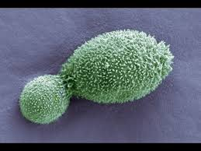
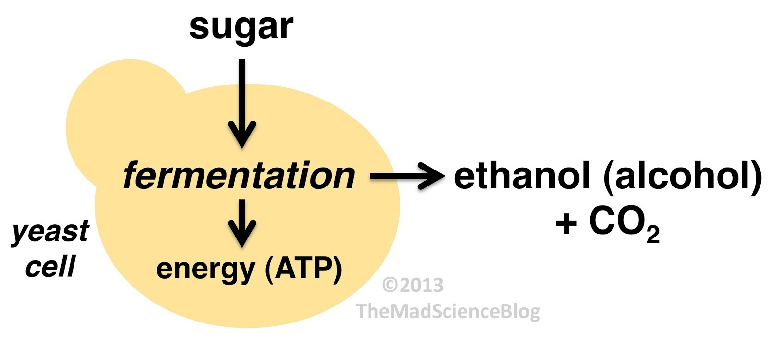
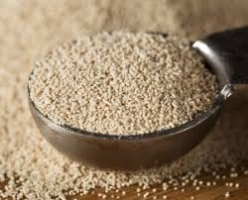
3.2.2 Ascomycetes
Yeasts are used for the production of ethanol and alcoholic beverages
Claviceps purperea is used for the production of the ergot alkaloids

Slide 21
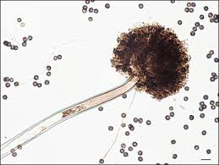
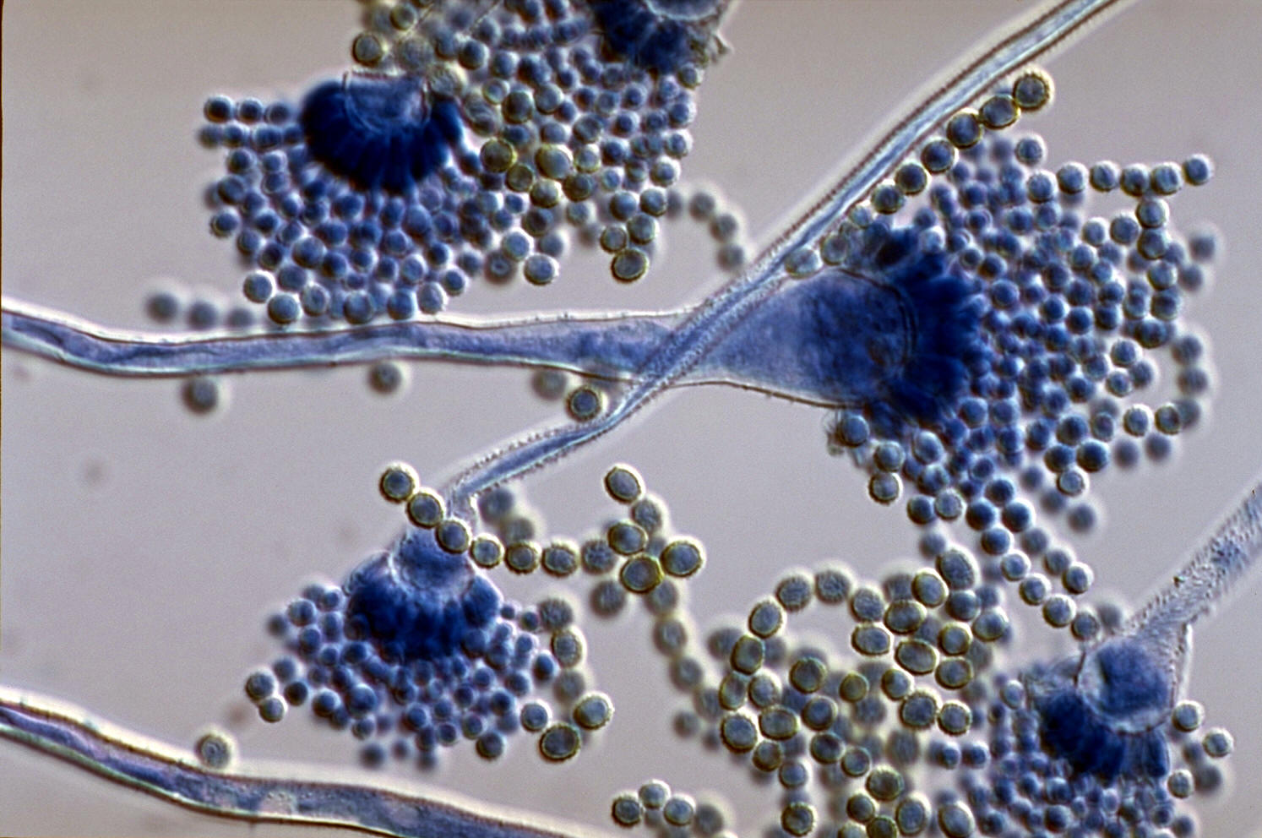
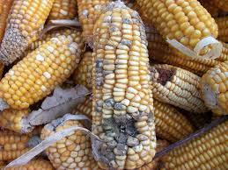
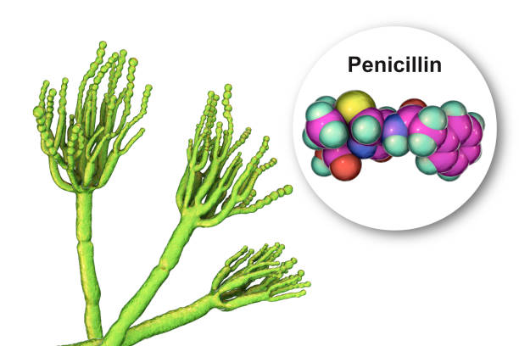
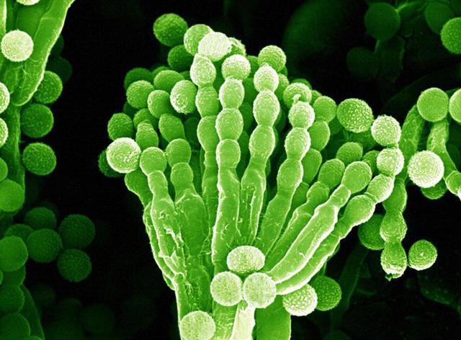
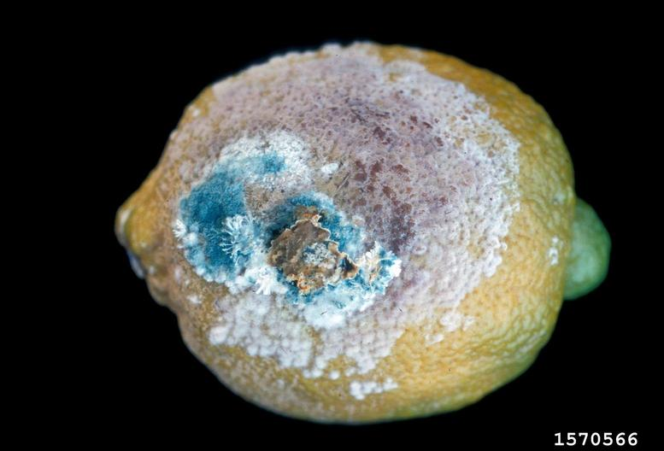
3.2.3 Fungi Imprfecti
Aspergillus is important because it produces the food toxin, aflatoxin.
Penicillium is well-known for the antibiotic penicillin which it produces.

Slide 22
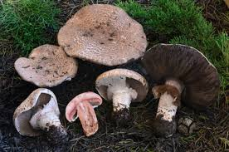
3.2.4 Basidiomycetes
Agaricus produces the edible fruiting body or mushroom

Slide 23
4. Important Characteristics of Industrial Microbes
i. The organism must be able to grow in a simple medium and should preferably not require growth factors (i.e. pre-formed vitamins, nucleotides, and acids) outside those which may be present in the industrial medium in which it is grown.
It is obvious that extraneous additional growth factors may increase the cost of the fermentation and hence that of the finished product.
ii. The organism should be able to grow vigorously and rapidly in the medium in use.
A slow growing organism no matter how efficient it is, in terms of the production of the target material, could be a liability. In the first place the slow rate of growth exposes it, in comparison to other equally effective producers which are faster growers, to a greater risk of contamination. Second, the rate of the turnover of the production of the desired material is lower in a slower growing organism and hence capital and personnel are tied up for longer periods, with consequent lower profits.

Slide 24
iii. Not only should the organism grow rapidly, but it should also produce the desired materials, whether they be cells or metabolic products, in as short a time as possible, for reasons given above.
iv. Its end products should not include toxic and other undesirable materials, especially if these end products are for internal consumption
v. The organism should have a reasonable genetic, and hence physiological stability.
An organism which mutates easily is an expensive risk. It could produce undesired products if a mutation occurred unobserved. The result could be reduced yield of the expected material, production of an entirely different product or indeed a toxic material. None of these situations is a help towards achieving the goal of the industry, which is the maximization of profits through the production of goods with predictable properties to which the consumer is accustomed.

Slide 25
vi. The organism should lend itself to a suitable method of product harvest at the end of the fermentation.
If for example a yeast and a bacterium were equally suitable for manufacturing a certain product, it would be better to use the yeast if the most appropriate recovery method was centrifugation. This is because while the bacterial diameter is approximately 1, yeasts are approximately 5. Assuming their densities are the same, yeasts would sediment 25 times more rapidly than bacteria. The faster sedimentation would result in less expenditure in terms of power, personnel supervision etc which could translate to higher profit.
vii. Wherever possible, organisms which have physiological requirements which protect them against competition from contaminants should be used.
An organism with optimum productivity at high temperatures, low pH values or which is able to elaborate agents inhibitory to competitors has a decided advantage over others. Thus a thermophilic efficient producer would be preferred to a mesophilic one

Slide 26
viii. The organism should be reasonably resistant to predators such as Bdellovibrio spp or bacteriophages.
It should therefore be part of the fundamental research of an industrial establishment using a phage-susceptible organism to attempt to produce phage-resistant but high yielding strains of the organism.
ix. Where practicable the organism should not be too highly demanding of oxygen as aeration (through greater power demand for agitation of the fermentor impellers, forced air injection etc) contributes about 20% of the cost of the finished product.
x. Lastly, the organism should be fairly easily amenable to genetic manipulation to enable the establishment of strains with more acceptable properties.

